Slide 1

Lead scoring assignment
Logistic regression

Slide 2
Problem statement: X education is an organization which provides online courses for industry professional. This company marks its courses on several popular websites. X education wants to select most promising leads that can be converted to paying customers . Although the company generates a lot of leads only a few are actually converted into paying customers. The company needs a higher lead conversion. This company has had 30% conversion rate throughout the process of turning leads .The process of leas generating attributes are not efficient in helping conversations. So, This company requires a model to be built for selection of the most promising leads. Lead score to be given to each leads such that it indicates how promising the lead could be . The higher the lead score the more promising the lead ton get converted , the lower the lead score the lesser the chances of conversion.

Slide 3
Strategy to create model:
Import data
Clean and prepare the acquired data for further analysis.
EDA for finding out most helpful attributes .
Scaling the features
Prepare the data for model building.
Build a logistic regression model
Test the model on train set
Evaluation of model by different measures and metrics.
Test the model on test set
Measure the accuracy of the model for evaluation.

Slide 4
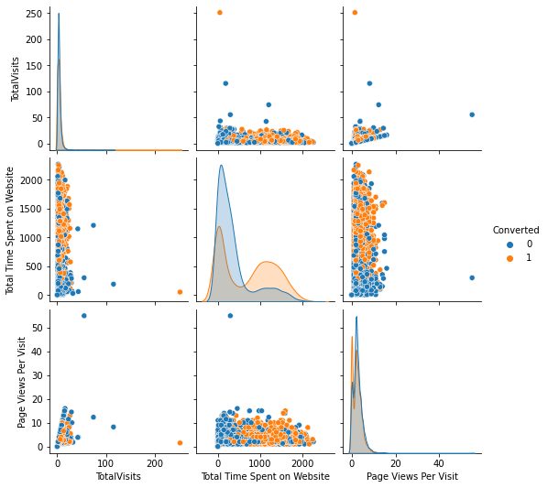
Data modelling
Three variables TotalVisits, Total time spent on website and page per view visit were plotted in a pairplot to observe the relations.
Among the three variables plotted on the pairplot Total time spent on website has the highest rate of conversion leads.

Slide 5
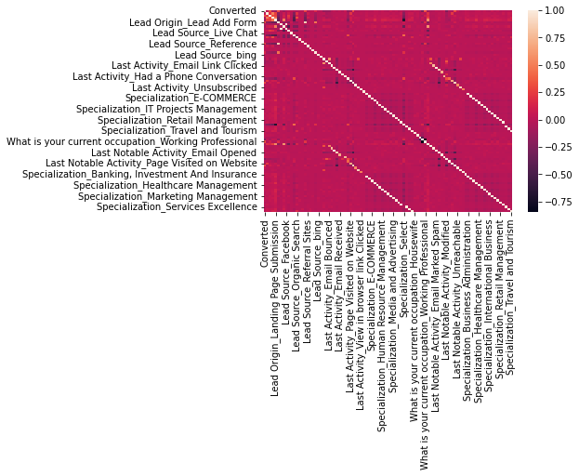
Correlations:
A heatmap was plotted to check the correlations among all the variables.

Slide 6
Model Building Process:
Splitting into train and test set.
Scale variables in train set
Build the first model
Using RFE to eliminate less relevant variables
Check VIF values for all existing columns
Predicting using Train set
Evaluation and predicting using Test set
Precision and recall analysis on test predictions

Slide 7
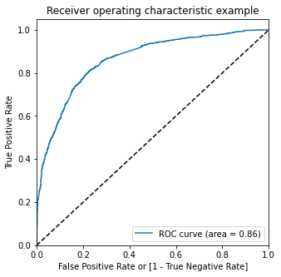
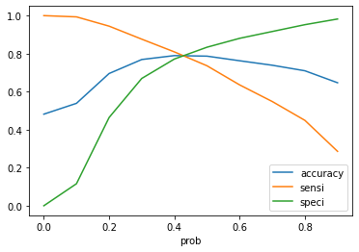
Model Evaluation
Accuracy : 0.83 sensitivity : 0.73
Accuracy : 0.78 sensitivity : 0.73

Slide 8
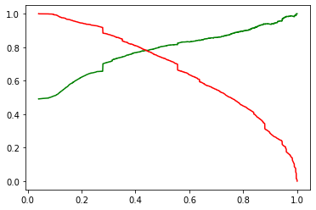
Model Evaluation Test:
Sensitivity : 0.88
Specificity : 0.55
Precision score : 0.64
Recall score : 0.88

Slide 9
Conclusion:
1. People spending higher than average time are promising leads, So targeting them and approaching them can be helpful in conversions.
2. An alert message or information has seen to have high conversation rate .
3. Marketing management and Human resources has high conversation rates. People from these specializations can be promising leads.
4. References and offers for referring a lead can be a good source for higher conversions.

